Slide 1
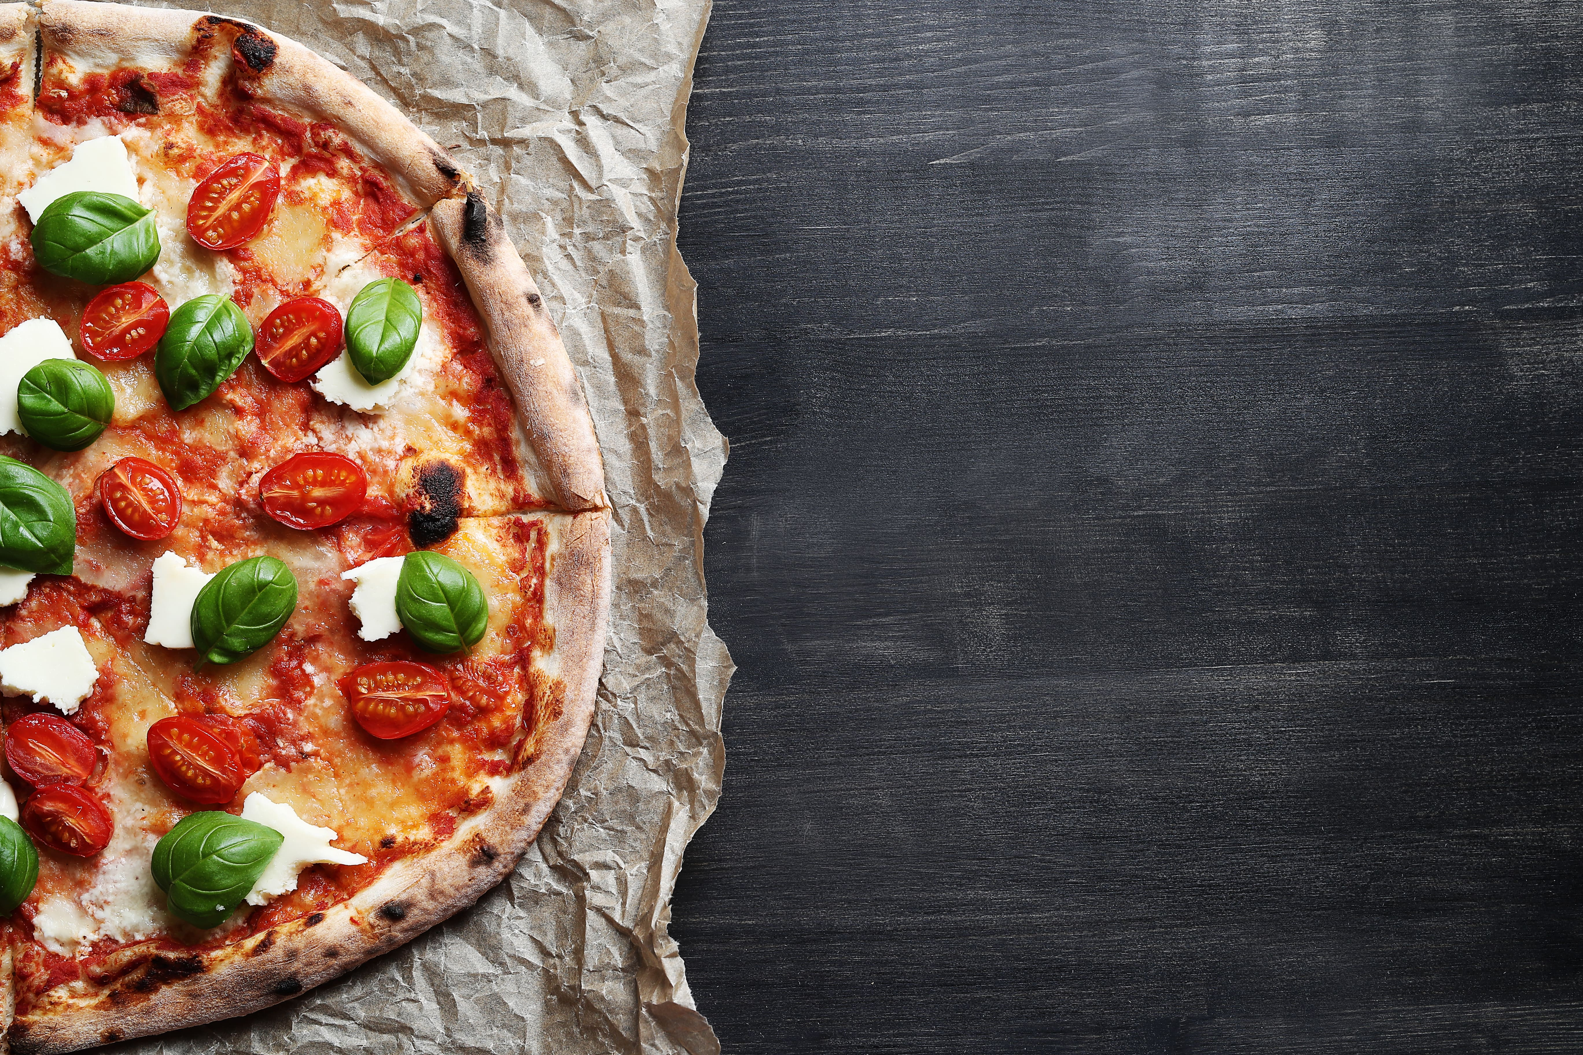
Pizza Sales Analysis: Data-Driven Insights for Strategic Decision Making

Slide 2
Table of contents
01
02
03
04
Project Overview
Business Questions
Technologies & Tools
Workflow
05
Insights
06
Conclusion

Slide 3
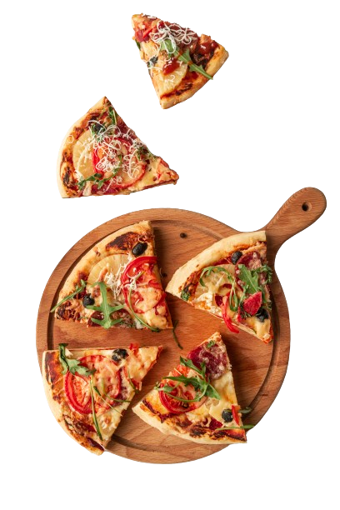
Project Overview
This project was undertaken to gain a deeper understanding of pizza sales dynamics, focusing on customer preferences, product performance, and revenue generation. The objective was to analyze the available data and deliver actionable insights that could guide strategic decisions and optimize sales outcomes
Through a focused SQL analysis, I accomplished:
An accurate assessment of total orders and revenue generated.
Identification of the most popular pizza types, sizes, and highest-priced items.
Insights into sales patterns by time of day and distribution across different pizza categories.
Strategic recommendations based on the top-performing products by quantity and revenue.

Slide 4
Business Questions
Retrieve the total number of orders placed.
Calculate the total revenue generated from pizza sales.
Identify the highest-priced pizza.
Identify the most common pizza size ordered.
List the top 5 most ordered pizza types along with their quantities.
Join the necessary tables to find the total quantity of each pizza category ordered.
Determine the distribution of orders by hour of the day.
Join relevant tables to find the category-wise distribution of pizzas.
Group the orders by date and calculate the average number of pizzas ordered per day.
Determine the top 3 most ordered pizza types based on revenue.
Calculate the percentage contribution of each pizza type to total revenue
Determine the top 3 most ordered pizza types based on revenue for each pizza category.

Slide 5


Tools & Techniques
MySQL Workbench
PowerPoint
MySQL Workbench was utilized for writing and executing SQL queries. This powerful tool facilitated efficient data extraction, manipulation, and analysis to uncover actionable insights from the sales data
PowerPoint was used to visualize the insights and present the findings in a clear, concise, and visually appealing manner. The visual storytelling helped in effectively communicating the key results and recommendations

Slide 6
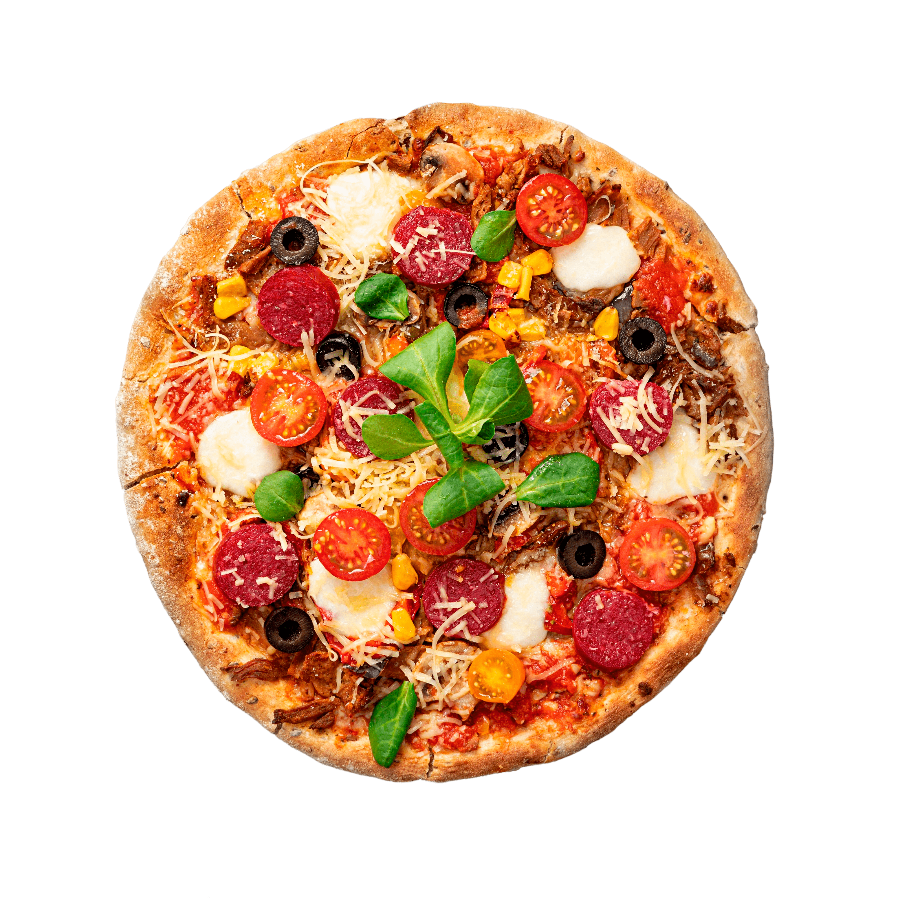
Workflow
1
3
Data Extraction
Data Loading
2
4
Insights
Data transformation

Slide 7
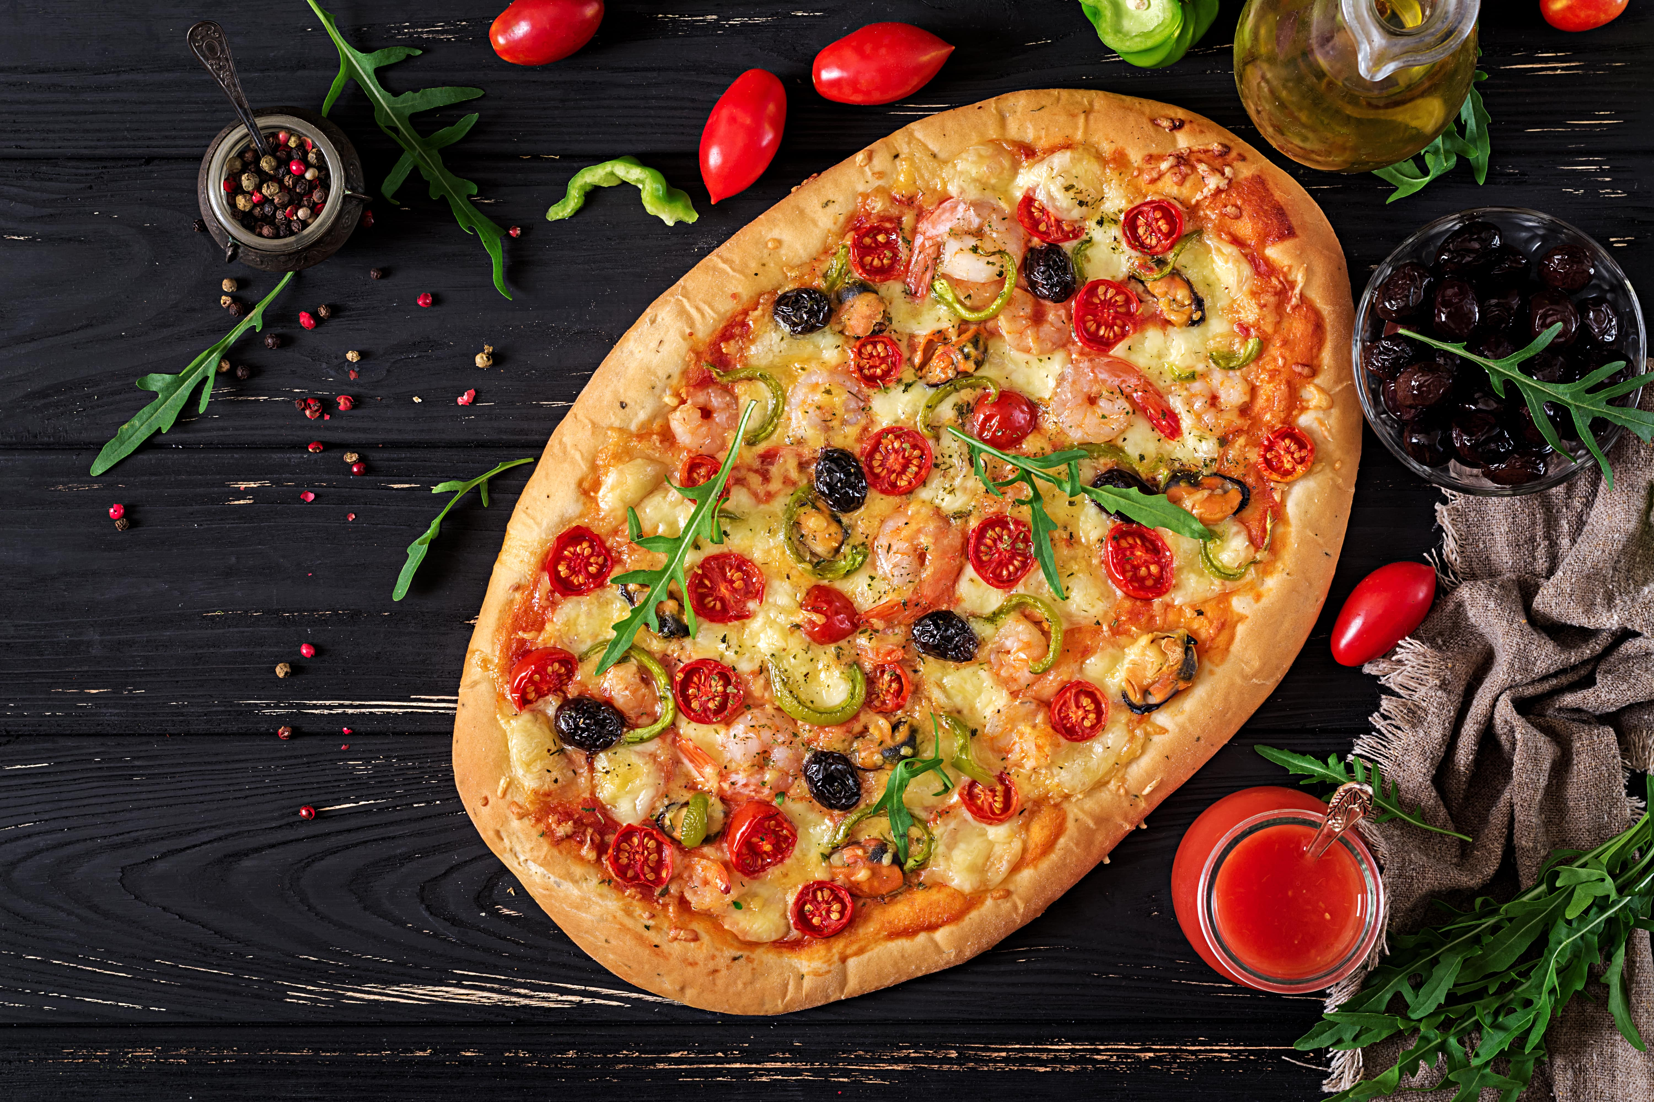
Business Questions

Slide 8
817860.05
Total Sales

Slide 9
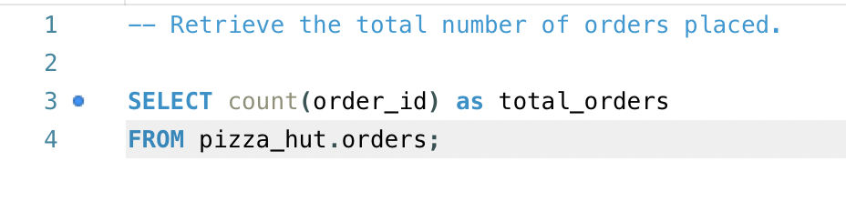
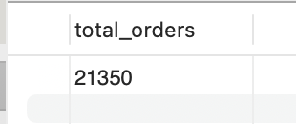
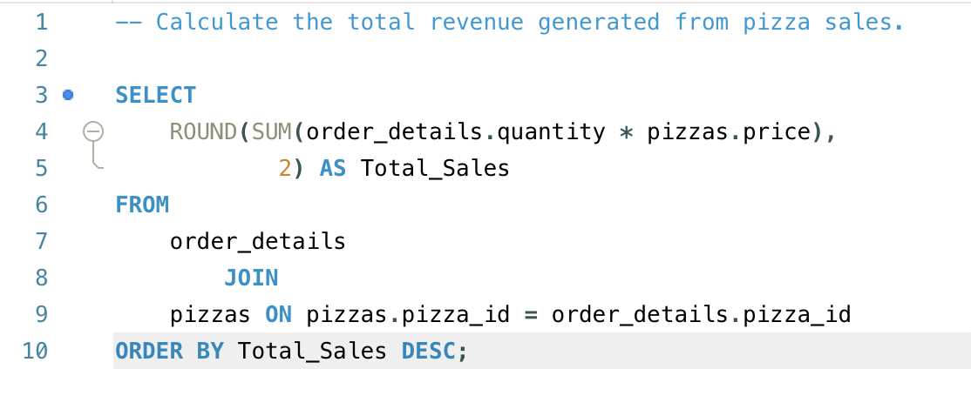
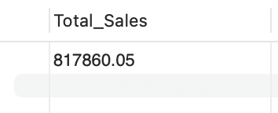
Business Questions
1- Retrieve the total number of orders placed.
2- Calculate the total revenue generated from pizza sales.

Slide 10
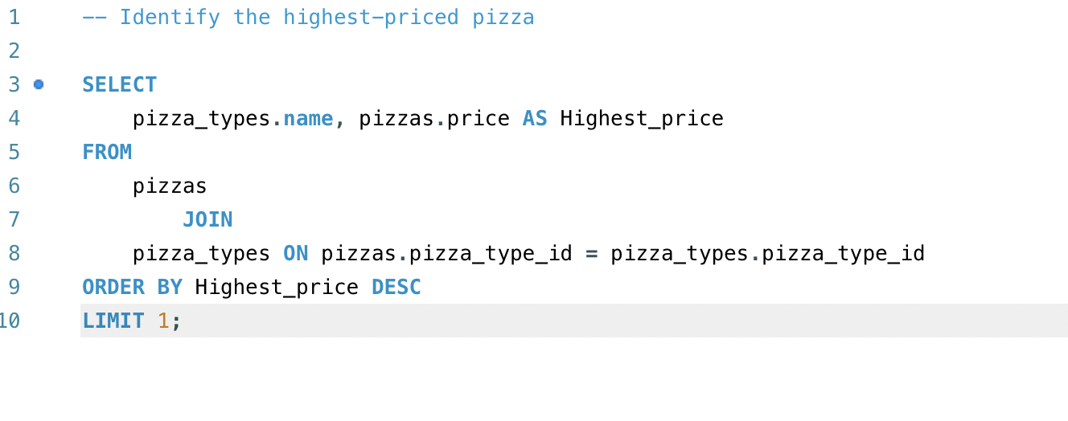
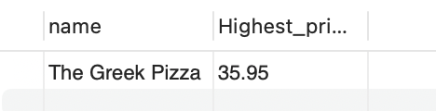
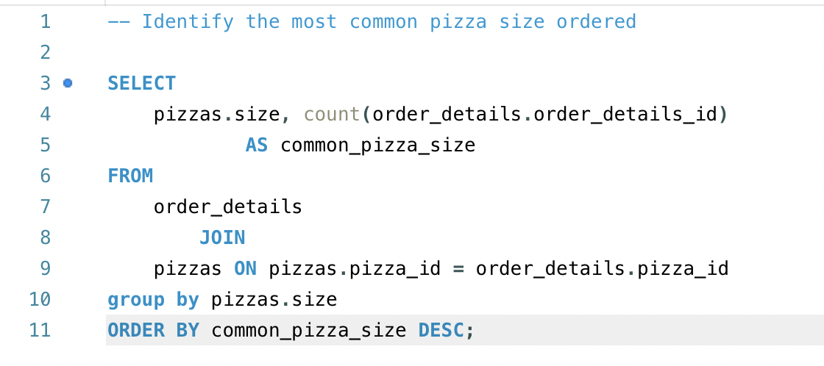
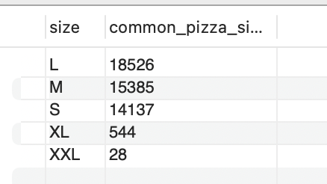
Business Questions
3- Identify the highest-priced pizza
4- Identify the most common pizza size ordered.

Slide 11
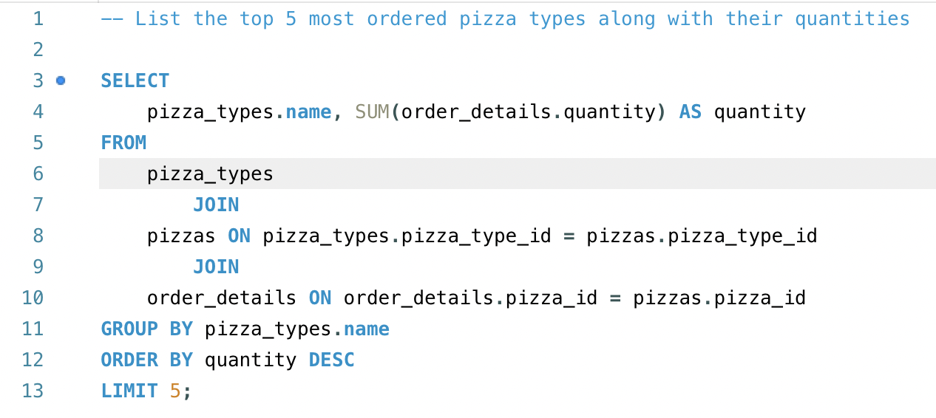
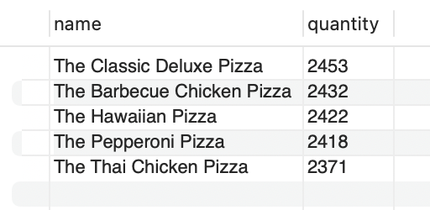
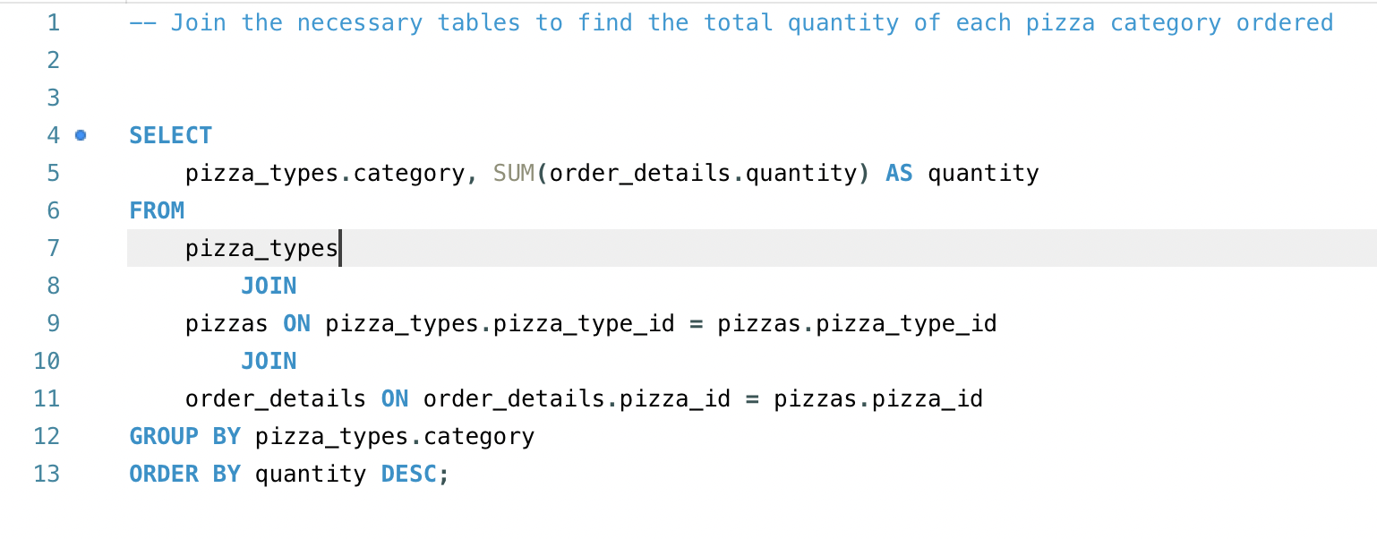
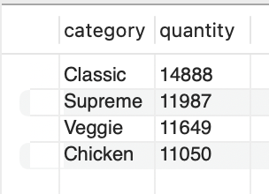
Business Questions
5- List the top 5 most ordered pizza types along with their quantities.
6- Join the necessary tables to find the total quantity of each pizza category ordered

Slide 12
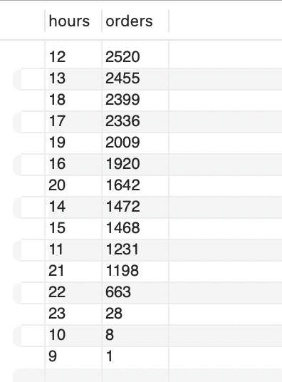
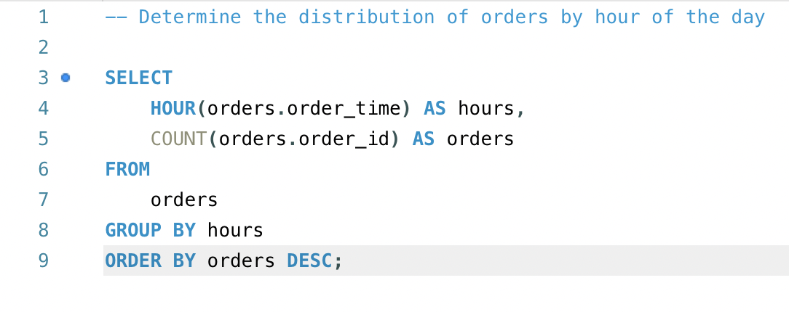
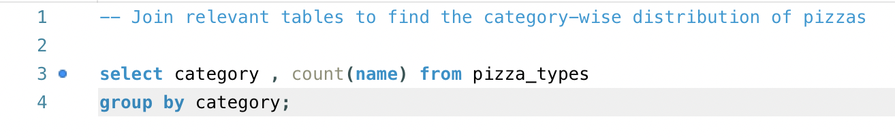
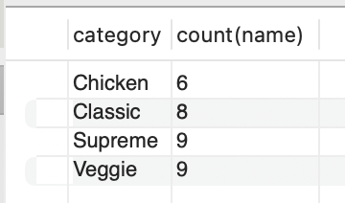
Business Questions
7- Determine the distribution of orders by hour of the day.
8- Join relevant tables to find the category-wise distribution of pizzas.

Slide 13
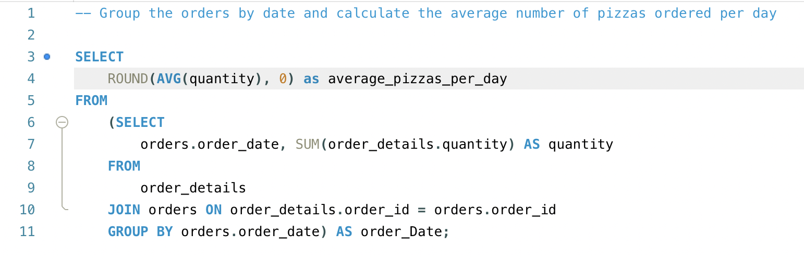
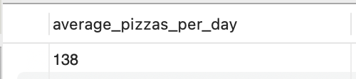
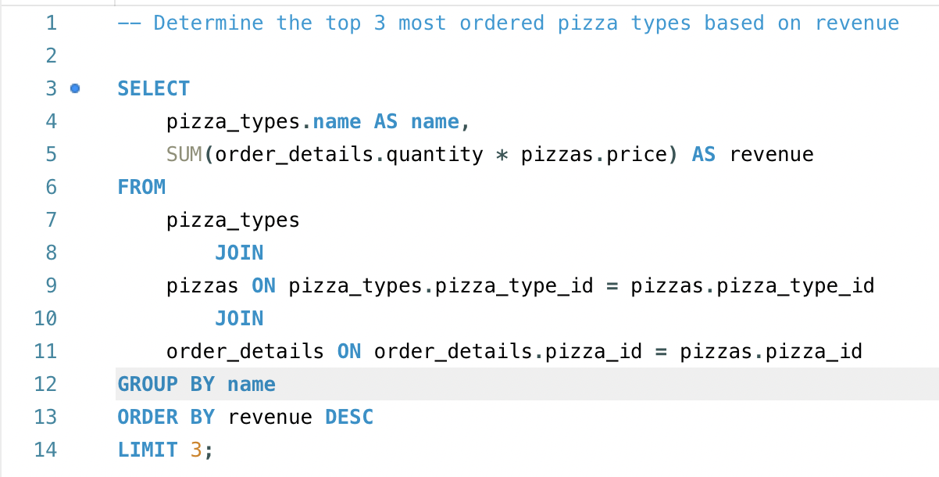
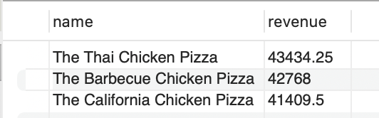
Business Questions
9- Group the orders by date and calculate the average number of pizzas ordered per day.
10- Determine the top 3 most ordered pizza types based on revenue.

Slide 14
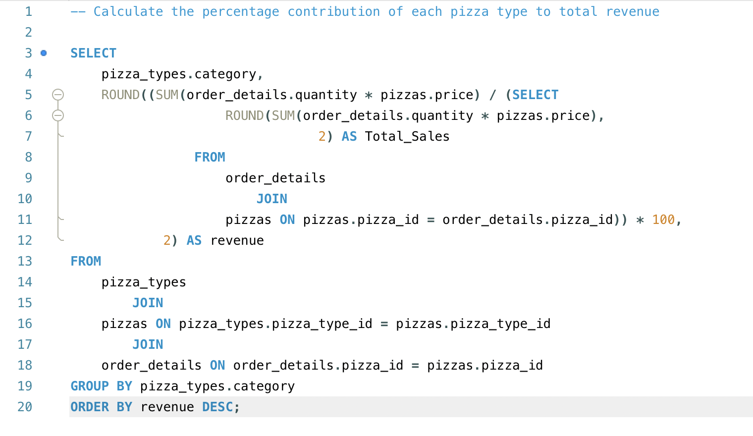
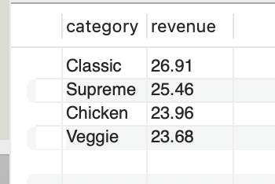
Business Questions
11-Calculate the percentage contribution of each pizza type to total revenue.

Slide 15
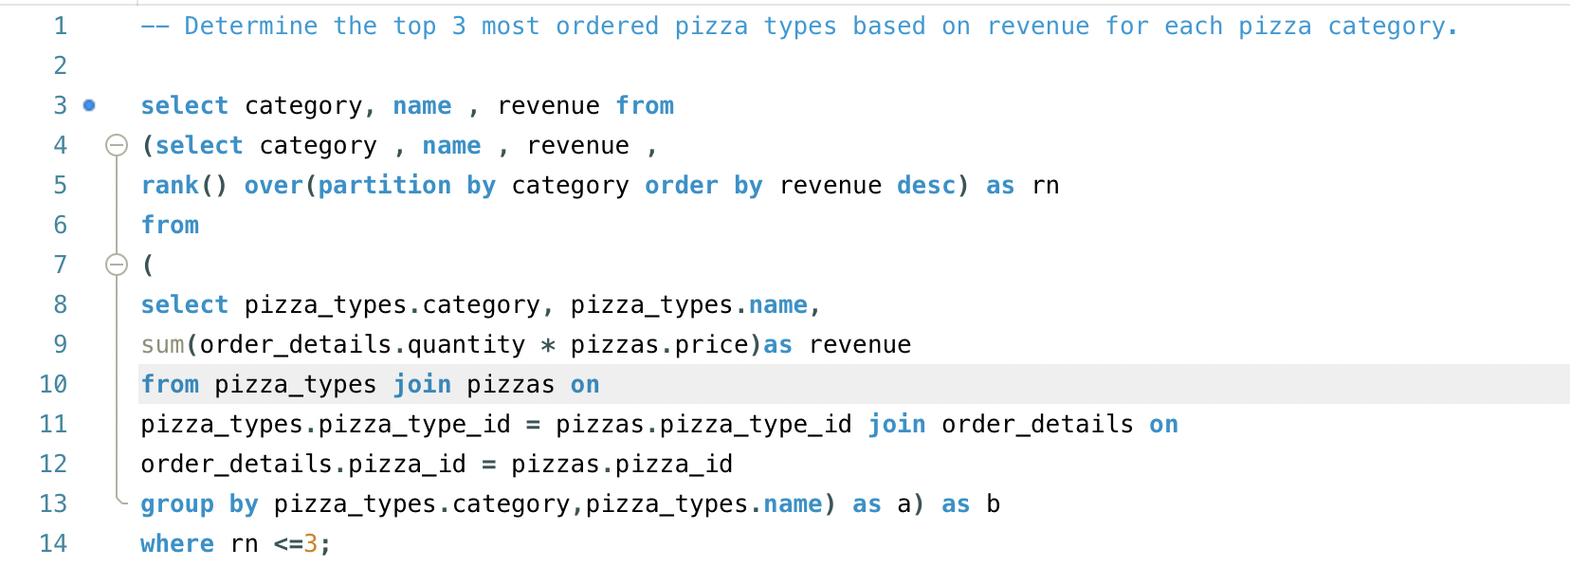
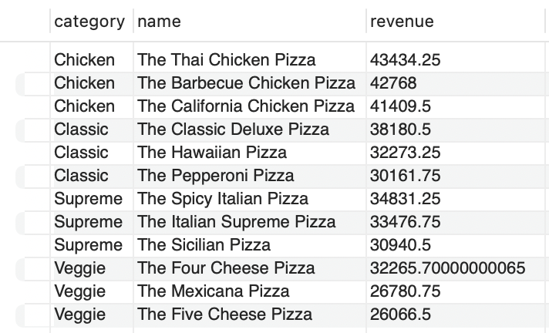
Business Questions
12- Determine the top 3 most ordered pizza types based on revenue for each pizza category."

Slide 16
Conclusion
Total sales reached 21,350 orders, generating over $817,860 in revenue, indicating robust demand.
The "Classic" category leads in revenue contribution with 26.91%, closely followed by "Supreme" at 25.46%, with "Chicken" and "Veggie" categories also making significant contributions.
"The Thai Chicken Pizza" is the top revenue-generating item at $43,434.25, showing strong customer preference for chicken-based pizzas.
Despite being a premium item, "The Greek Pizza" stands out as the highest-priced option, suggesting potential for expanding premium offerings
Large pizzas are the most popular, with 18,526 orders, highlighting size preference among customers.
Peak order times are around midday, specifically at 12 PM and 1 PM, suggesting these are optimal times for targeted promotions.
The "Classic Deluxe Pizza" and "The Four Cheese Pizza" are strong performers within their respective categories, contributing significantly to overall revenue

Slide 17
Recommendations
Focus marketing efforts during peak midday hours with special promotions, discounts, or combo deals to capitalize on high order volumes.
Introduce additional premium pizzas, leveraging the success of "The Greek Pizza," to cater to customers seeking gourmet options.
Highlight and promote top-performing pizzas like "The Thai Chicken Pizza" and "The Classic Deluxe Pizza" in marketing campaigns, potentially bundling them with popular sides to increase order value.
Develop targeted campaigns that appeal to different customer segments, given the strong performance of "Classic," "Supreme," and "Veggie" categories.
Introduce special evening discounts or happy hour deals to boost sales during off-peak evening hours.
Enhance customer loyalty programs by rewarding repeat purchases of popular pizzas, encouraging repeat business and customer retention.

Slide 18
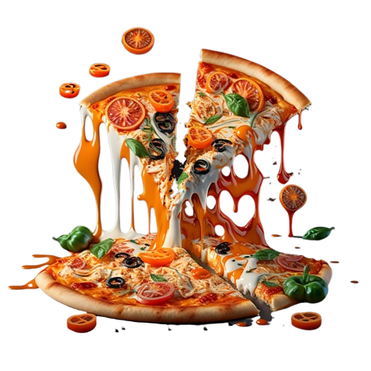
Thanks!
Do you have any questions?

